Slide 1
Evaluation of a non-linear function to represent subsurface outflow and tile drainage.
Nicolas Velasquez, Ricardo Mantilla, Felipe Quintero, Morgan Fonley, Witek Krajewsky,

Slide 2
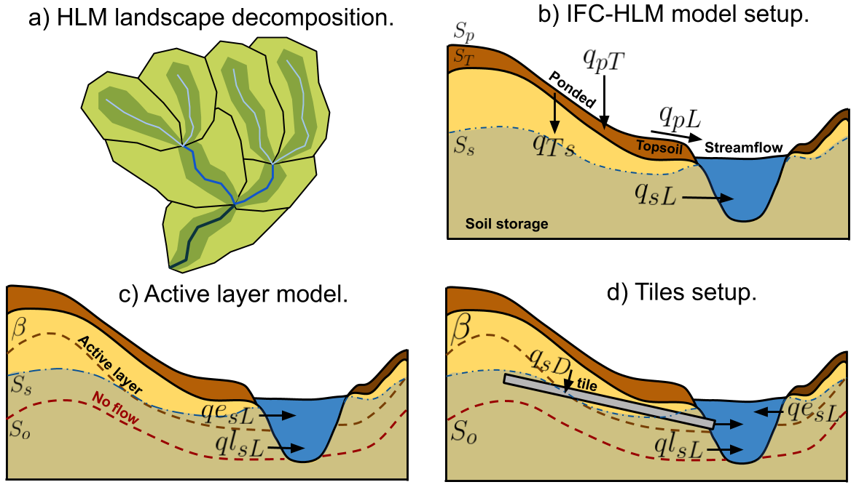
For the evaluation we use a version of the HLM model that has an active layer on the subsurface, and the option to include tile drainage.

Slide 3
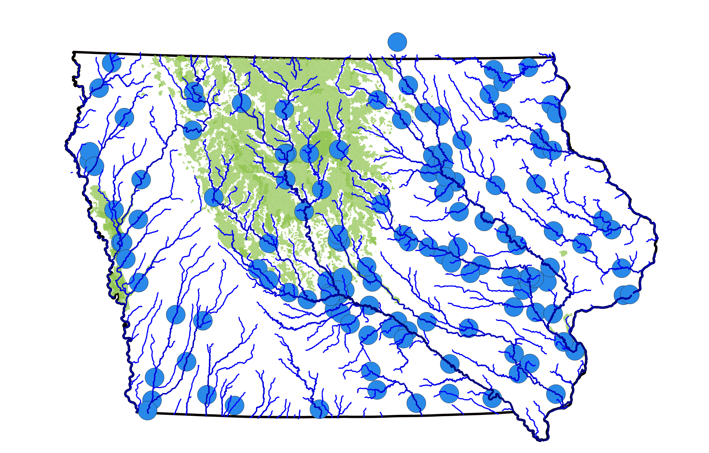
With the new model, we consider three new scenarios between 2002 and 2018: active layer (undrained), tiled (drained), and distributed drained (green).

Slide 4
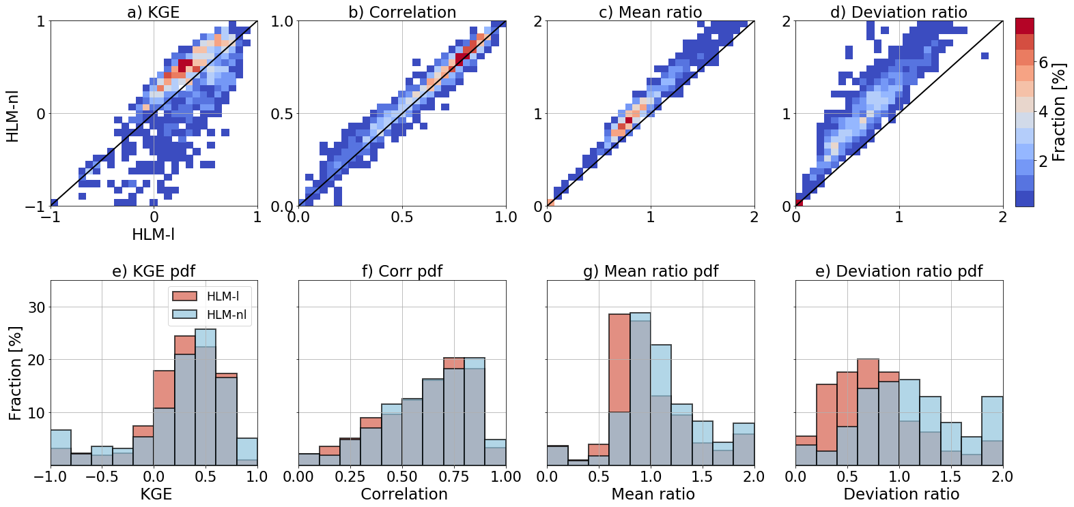
The HLM-nl setup increases the yearly KGE performance. We attribute this increase performance at the Mean and Deviation biases.
Notes:
Cambiar por HLM linear-Ss, HLM non-linear-Ss. Variance bias, Mean bias

Slide 5
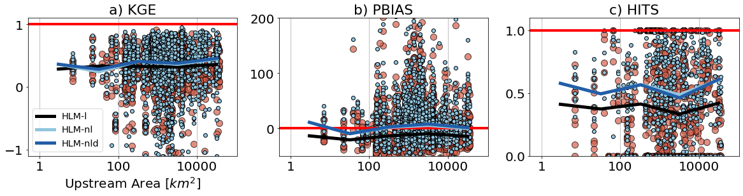
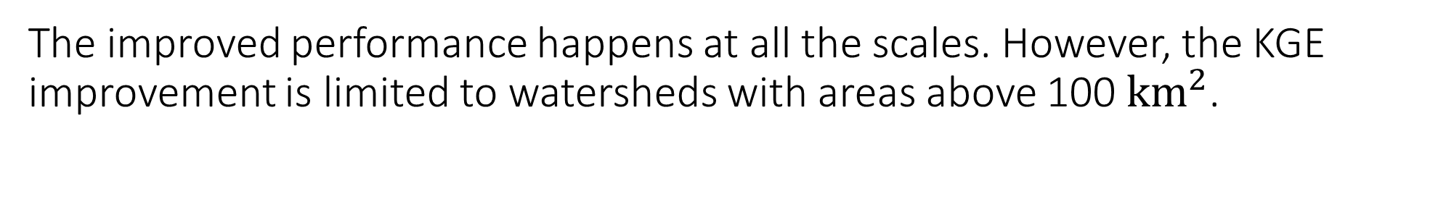
The improved performance happens at all the scales. However, the KGE improvement is limited to watersheds with areas above 100 ${km}^{2}$.

Slide 6
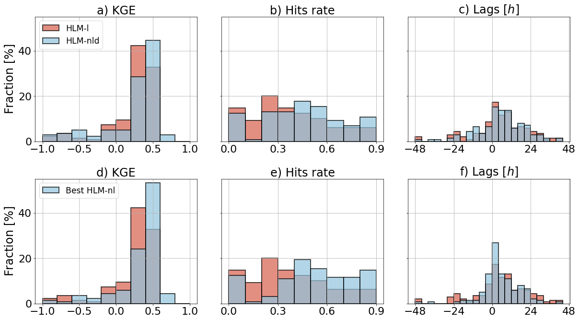
With the new model, we consider three new scenarios between 2002 and 2018: active layer (undrained), tiled (drained), and distributed drained (green).

Slide 7
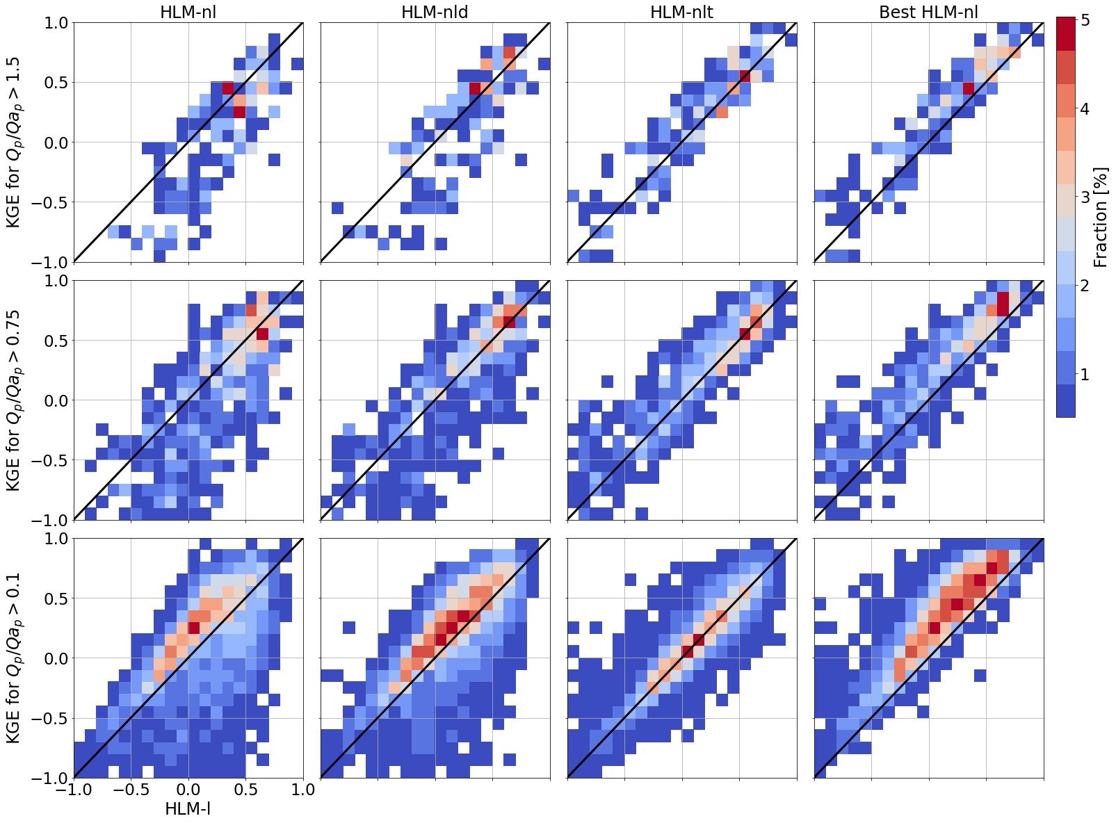
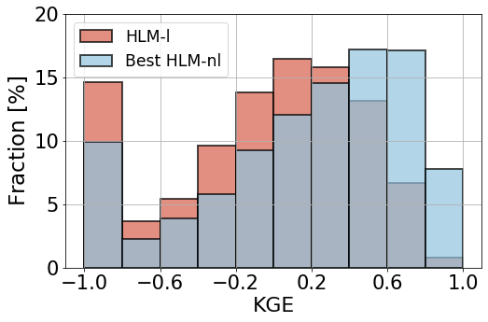
With the new model, we consider three new scenarios between 2002 and 2018: active layer (undrained), tiled (drained), and distributed drained (green).

Slide 8
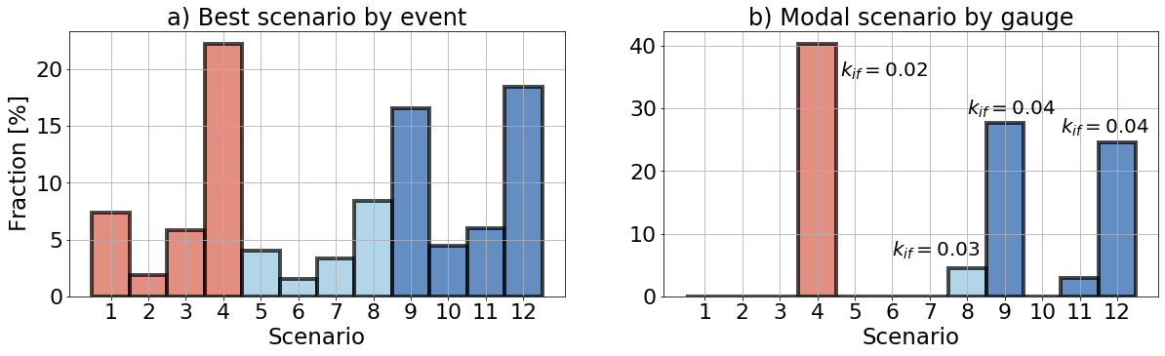
Some of the scenarios are dominant in the region.

Slide 9
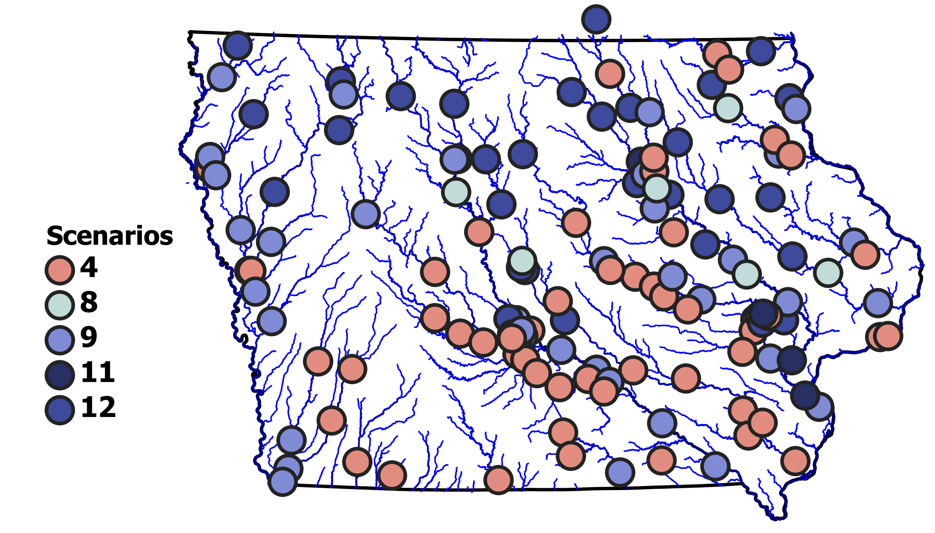
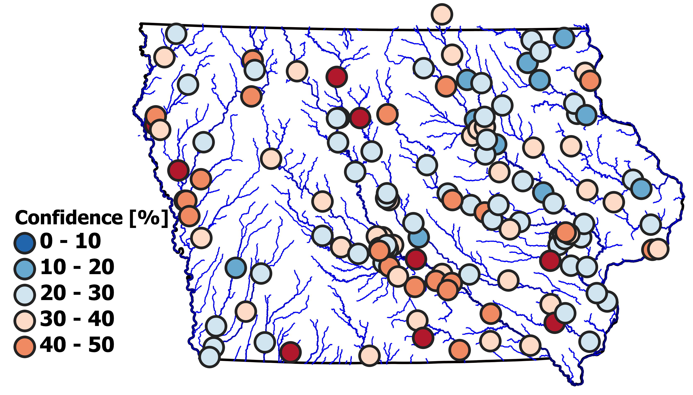
The selected scenarios also have an spatial distribution inside Iowa.
a) Scenarios selected for each gauge
b) Confidence of the selected scenarios.

Slide 10
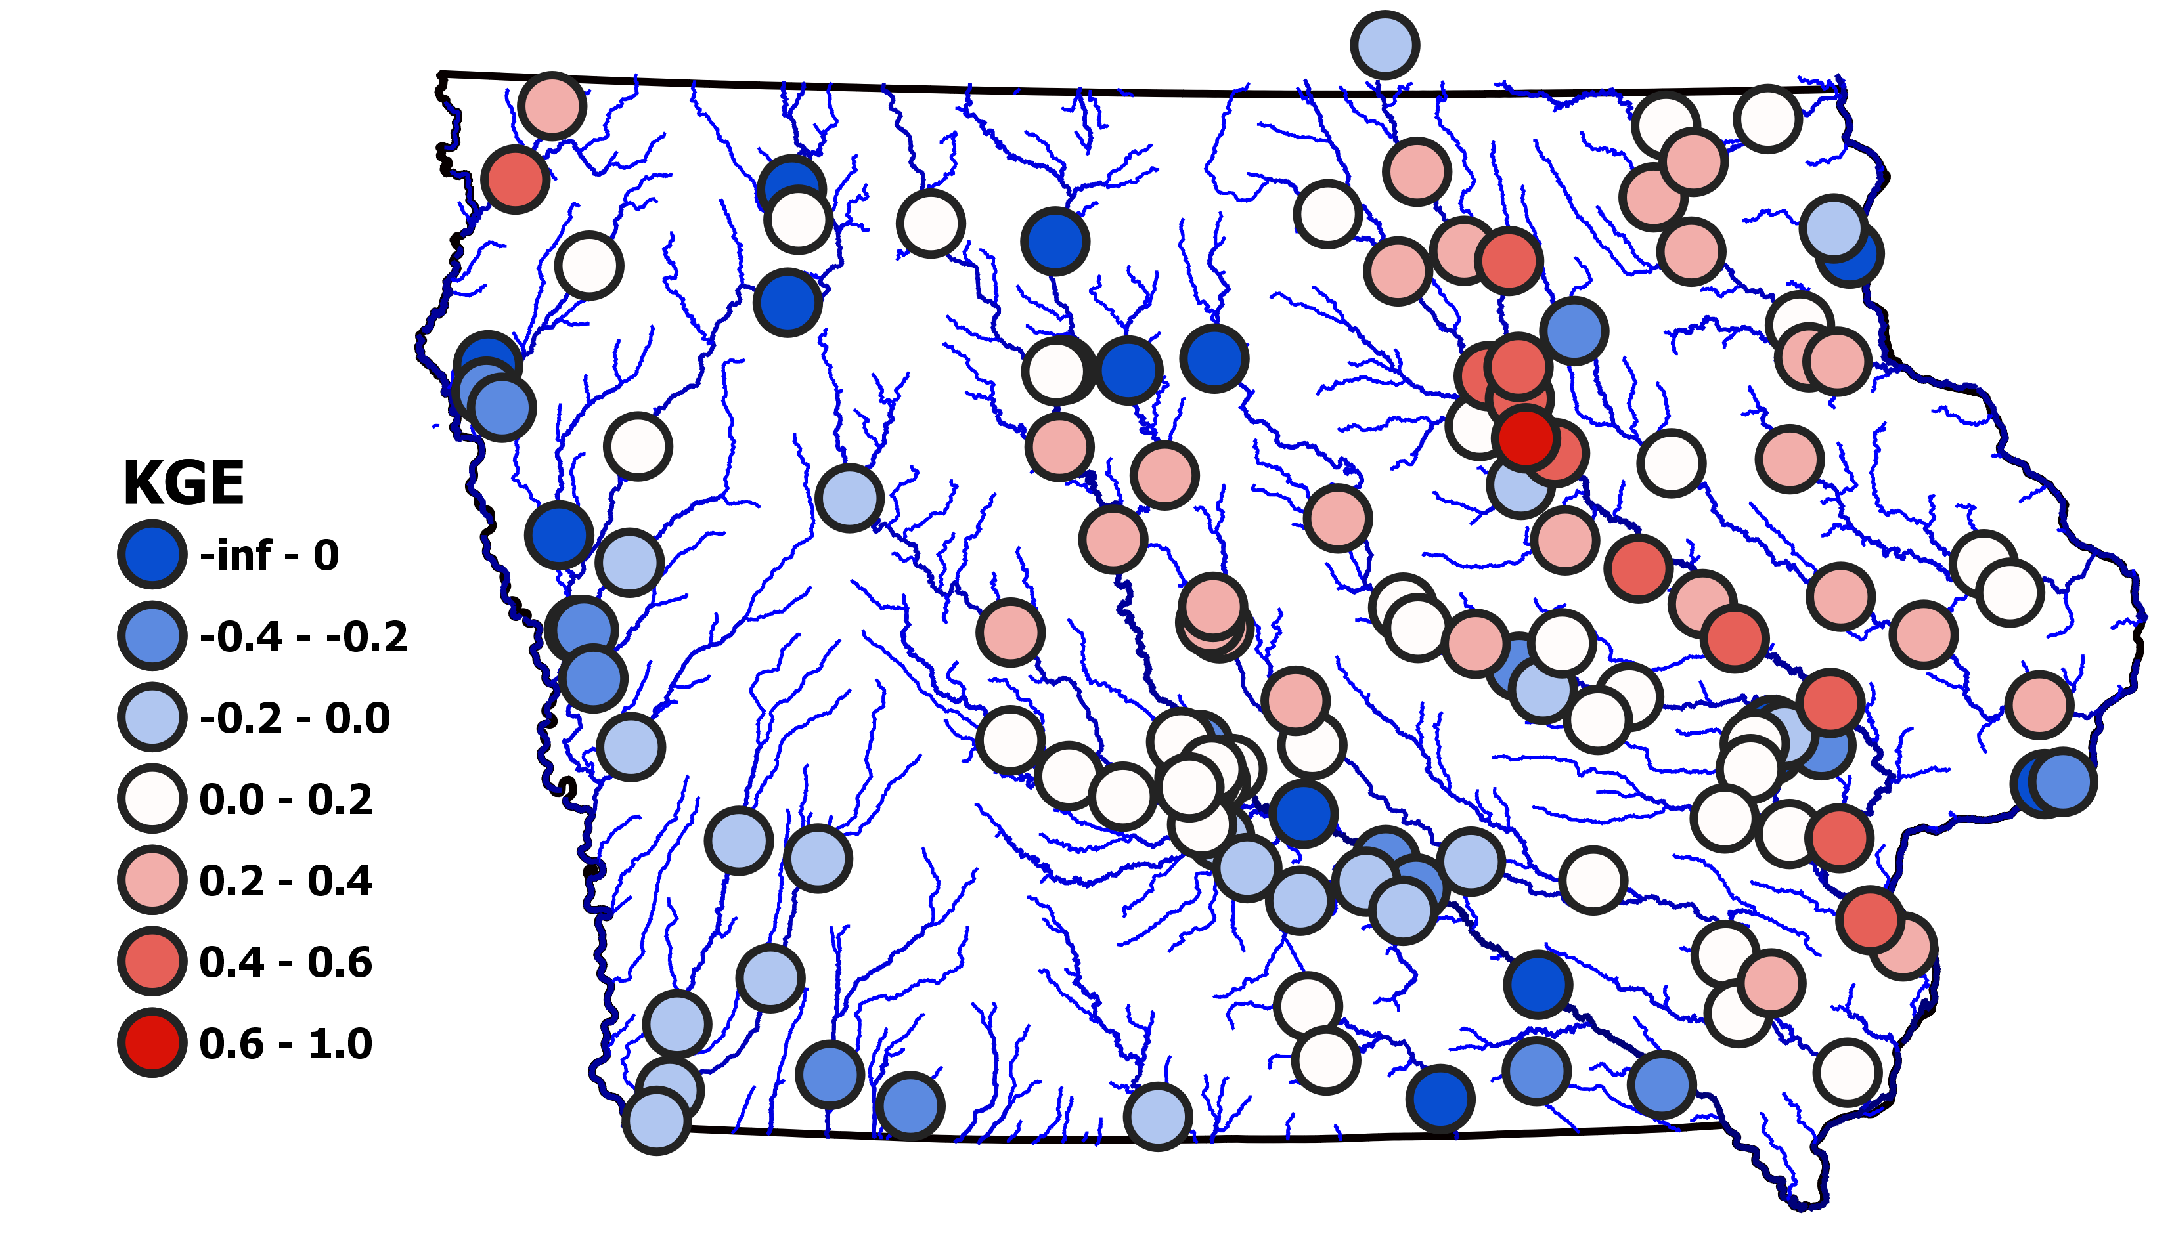
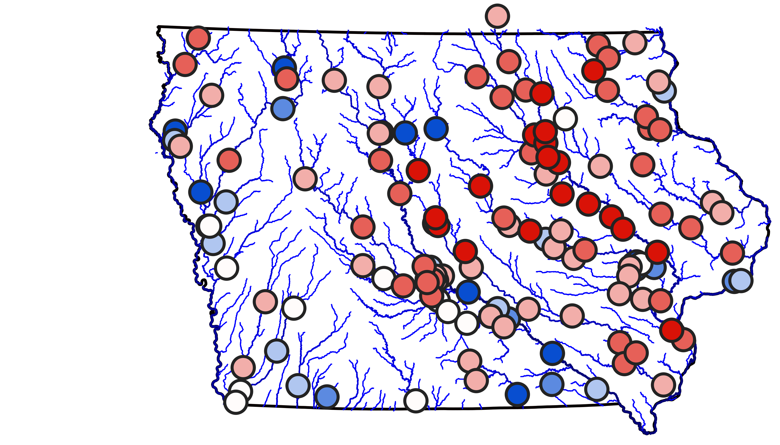
Compared with the HLM-l, the best scenario of the HLM-nl produces a significant improvement at different regions of Iowa.
a) KGE for the HLM-l
b) KGE for the best HLM-nl

Slide 11
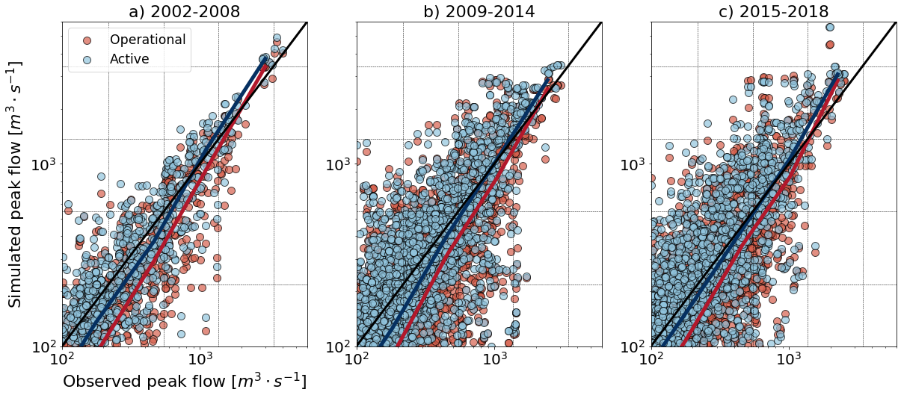
With the new model, we consider three new scenarios between 2002 and 2018: active layer (undrained), tiled (drained), and distributed drained (green).
Notes:
Normalizarlo

Slide 12
